Slide 1
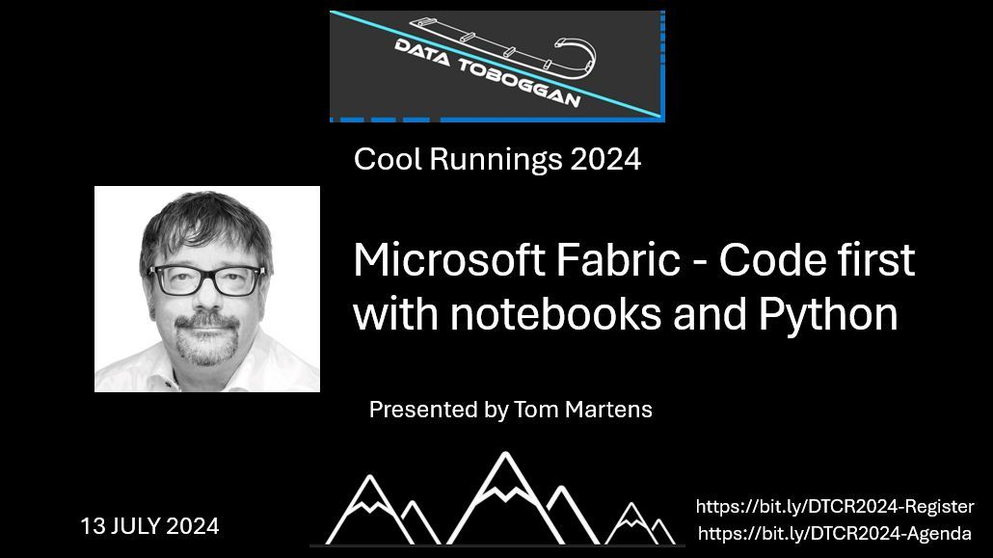
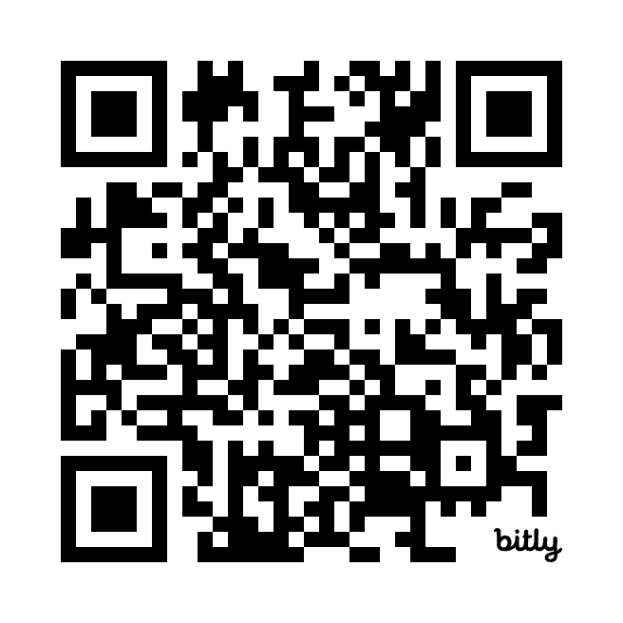
Code First with Microsoft Fabric and Notebooks
Use the QR code to go to the slides
Tom Martens @ Data Toboggan Cool Runnings
2024-07-13

Slide 2
What this session is about
Since the advent of Microsoft Fabric, more capabilities for solving our data engineering tasks have entered the stage. Next to dataflows (Gen2), creating data pipelines based on Azure Data Factory is possible now. However, my favorite method to tackle data engineering challenges has been notebooks. However, I do not use Python and PySpark for data engineering tasks alone. I also use Python to extract data from REST APIs. In this session, I demonstrate how I use Python to extract data from REST APIs, including using secrets stored inside an Azure Key Vault. Next, I will showcase how common and not-so-common data cleansing and transformation tasks can be tackled using Python and PySpark. This session will introduce Python for data engineering but will also cover advanced techniques like user-defined functions, method chaining, and package management. All examples will be available for download from a public git repo. Also, this session is an introduction to data engineering using Python, especially PySpark. Some experience using programming languages will be helpful to follow every aspect covered in this session.

Slide 3
What this session is about
Since the advent of notebooks inside Microsoft Fabric, more capabilities for solving our data engineering tasks have entered the stage. Next to dataflows (Gen2), creating data pipelines based on Azure Data Factory is possible now. However, my favorite method to tackle data engineering challenges has been notebooks. However, I do not use Python and PySpark for data engineering tasks alone. I also use Python to extract data from REST APIs. In this session, I demonstrate how I use Python to extract data from REST APIs, including using secrets stored inside an Azure Key Vault. Next, I will showcase how common and not-so-common data cleansing and transformation tasks can be tackled using Python and PySpark. This session will introduce Python for data engineering but will also cover advanced techniques like user-defined functions, method chaining, and package management. All examples will be available for download from a public git repo. Also, this session is an introduction to data engineering using Python, especially PySpark. Some experience using programming languages will be helpful to follow every aspect covered in this session.

Slide 4
Inside the box
Who I am
A (really) short introduction to Python and PySpark
The vault that holds your keys
Demo time

Slide 5

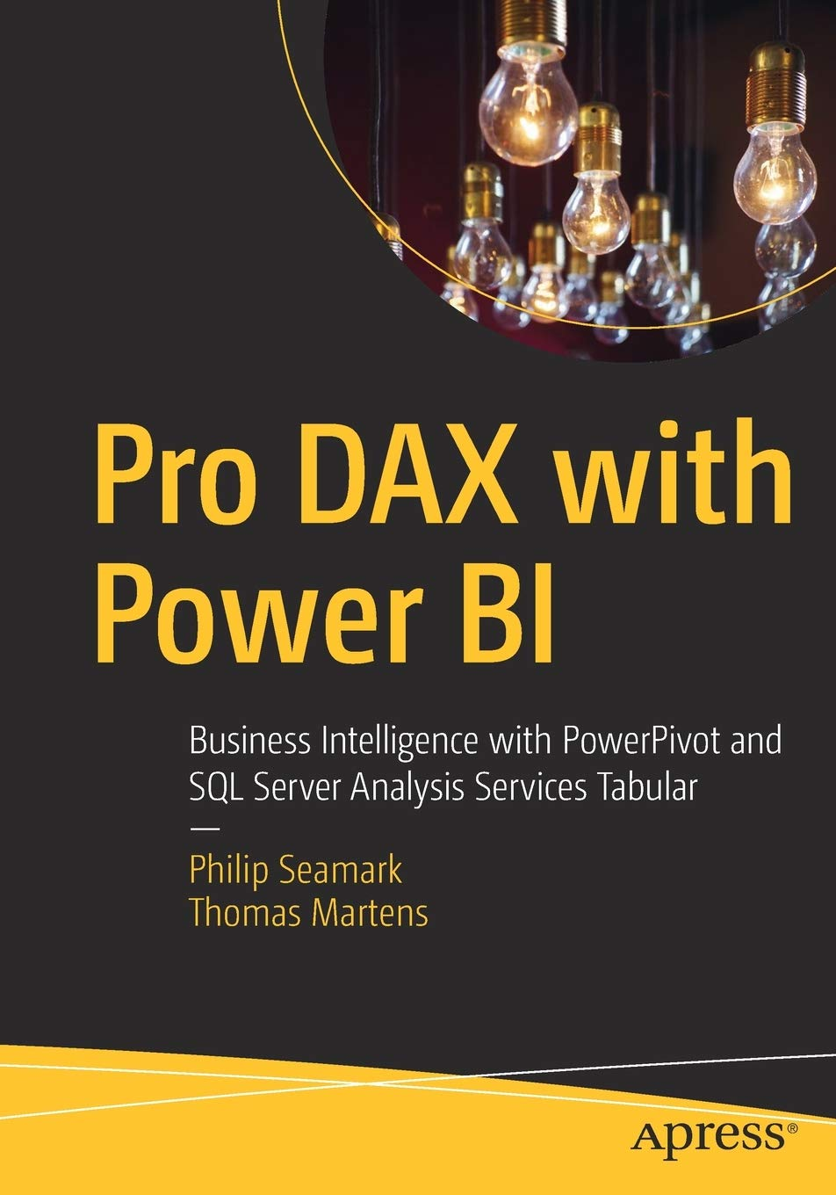

Tom Martens
25+ years of experience designing analytical solutions using the MSFT data platform
Solution Architect @ Munich Re
/tommartens68
@tommartens68

Slide 6
A really short Introduction to Python and PySpark

Slide 7
What is Python
Python is a programming language that lets you work more quickly and integrate your systems more effectively.
Welcome to Python.org

Slide 8
What is PySpark?
PySpark is the Python API for Apache Spark. It enables you to perform real-time, large-scale data processing in a distributed environment using Python. It also provides a PySpark shell for interactively analyzing your data.
PySpark Overview — PySpark master documentation (apache.org)

Slide 9
Why I love this …
I do not need to compile anyting, the managing of different Python versions and package versions can become a challenge though.
When working with Python in Microsoft Fabric I do not need to take care of an IDE.
I’m in full control of any single bit, at least most of the time.
From my experience using PySpark is faster than Data Pipelines and Data Flow Gen2. Keep in mind that a Pandas data frame is not the same as a PySpark data frame though.
Delta Tables support UPSERT.
Notebooks can be shared easily

Slide 10
… and because of this
Beautiful is better than ugly.
Explicit is better than implicit.
Simple is better than complex.
Complex is better than complicated.
Flat is better than nested.
Sparse is better than dense.
Readability counts.
Special cases aren't special enough to break the rules.
Although practicality beats purity.
Errors should never pass silently.
Unless explicitly silenced.
In the face of ambiguity, refuse the temptation to guess.
There should be one-- and preferably only one --obvious way to do it. Although that way may not be obvious at first unless you're Dutch. Now is better than never.
Although never is often better than *right* now.
If the implementation is hard to explain, it's a bad idea.
If the implementation is easy to explain, it may be a good idea.
Namespaces are one honking great idea -- let's do more of those!
PEP 20 – The Zen of Python | peps.python.org

Slide 11

The solution! (at least a first draft)
The link to the github repo: https://bit.ly/TenantMonitoring

Slide 12
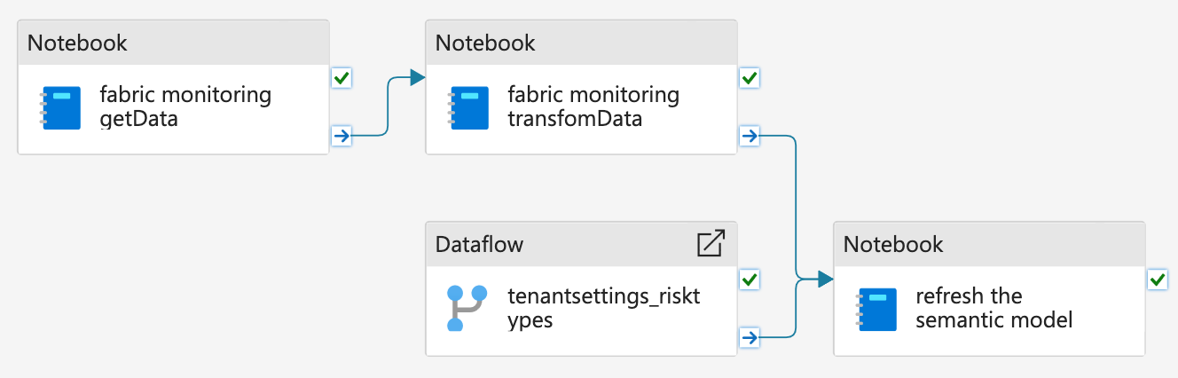
The pipeline

Slide 13

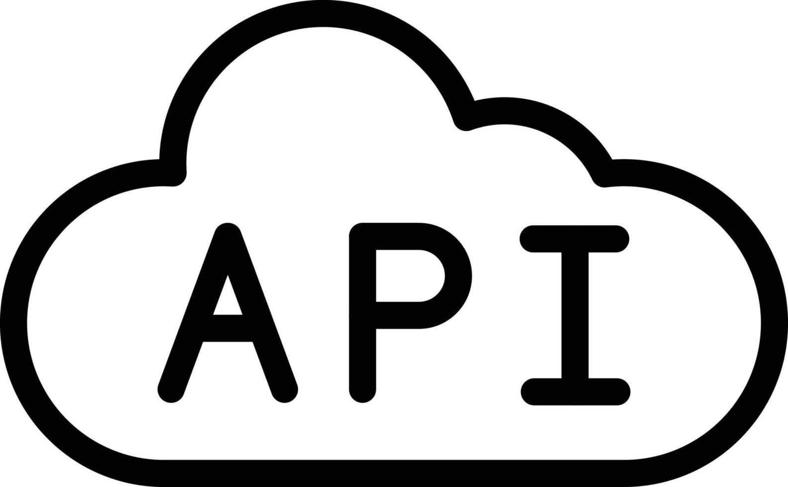


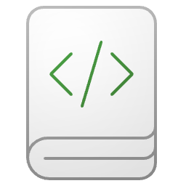


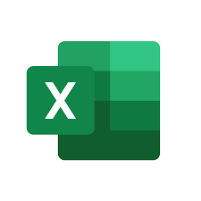


The overall architecture Schematic view
Pipeline
Lakehouse
Semantic Model
The Report
Delta Tables and JSON files

Slide 14
Demo time almost
The link to the github repo: https://bit.ly/TenantMonitoring

Slide 15

Me, learning/using Python (remembers me at the time when I learned DAX)

Slide 16

Some concepts
Import (5. The import system — Python 3.12.4 documentation) “Python code in one module gains access to the code in another module by the process of importing it.”
python - What exactly does "import *" import? - Stack Overflow
User defined functions (pyspark), handle with care when used inside dataframe manipulation or projection
Method chaining
Orchestrate noteboos: Data pipeline or runMultiple (Microsoft Spark Utilities (MSSparkUtils) for Fabric - Microsoft Fabric | Microsoft Learn)

Slide 17

The vault that holds your keys (maybe)
The link to the github repo: https://bit.ly/TenantMonitoring

Slide 18

How to add a secret to a vault
Key Vault
Permission (inherited): User Access Administrator
It’s me (subscription contributor)
Permission (granted): Key Vault Secrets User
Permission (granted): Key Vault Secrets Officer
Someone else (the SPN)
Create/Read
Secret
Read

Slide 19
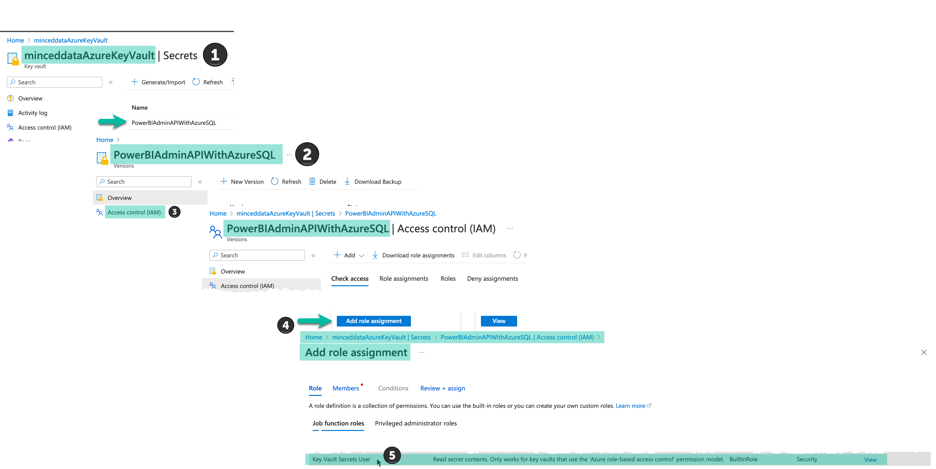
How to add a secret to a vault

Slide 20
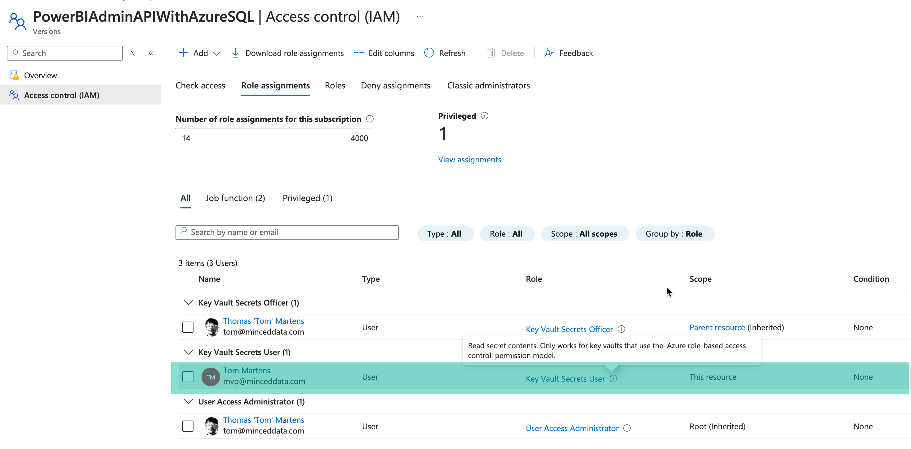
How to add a secret to a vault

Slide 21

Some readings
The link to the github repo: https://bit.ly/TenantMonitoring

Slide 22
Resources
BeginnersGuide - Python Wiki
Apache Spark runtime in Fabric - Microsoft Fabric | Microsoft Learn
Manage Apache Spark libraries - Microsoft Fabric | Microsoft Learn
https://learn.microsoft.com/en-us/fabric/admin/about-tenant-settings
https://learn.microsoft.com/en-us/azure/key-vault/general/overview
https://learn.microsoft.com/en-us/fabric/
Accessing Azure Key Vault Secrets from Fabric Notebooks (robkerr.ai)

Slide 23
Thank you
The link to the github repo: https://bit.ly/TenantMonitoring

